Slide 1
Digital Portfolio
STUDENT NAME: Rinilkumar M
REGISTER NO AND NMID: 0ED39DEBB47104B963D494B1DDCBCEF DEPARTMENT: BSC COMPUTER SCIENCE
COLLEGE: COLLEGE/ UNIVERSITY GOVERNMENT ARTS AND SCIENCE COLLEGE METTUPALAYAM/BHARATHIYAR UNIVERSITY

Slide 2
PROJECT TITLE
DIGITAL PORTFOLIO

Slide 3


AGENDA
Problem Statement
Project Overview
End Users
Tools and Technologies
Portfolio design and Layout
Features and Functionality
Results and Screenshots
Conclusion
Github Link
3/21/2024 Annual Review

Slide 4

PROBLEM STATEMENT
Students often need a well-structured, responsive, and interactive portfolio website to showcase their skills, projects, and contact details for internships and job opportunities. The challenge is creating a clean, responsive design with working functionality (like contact form) using only HTML, CSS, and JavaScript.

Slide 5

PROJECT OVERVIEW
This project is a personal portfolio website designed for students to Display their introduction and skills Showcase projects with brief descriptions Include a contact form for communication The portfolio uses HTML for structure.CSS for design and responsiveness JavaScript for smooth scrolling and form interaction Formspree for sending form data to email without backend coding.

Slide 6

WHO ARE THE END USERS?
Students: To present their work for internships/jobs Recruiters & Companies: To review student profiles quickly Educators & Trainers: For evaluating student portfolio projects.

Slide 7

TOOLS AND TECHNIQUES
HTML5 – Page structure.
CSS3 – Styling, layout design, and visual elements.
JavaScript (Vanilla) – Smooth scroll functionality.
Form spree API – Email integration for the contact form.
VS Code – Development environment.
Web Browser – For testing (Chrome, Firefox).

Slide 8
POTFOLIO DESIGN AND LAYOUT
Portfolio Design and Layout
✔ Header Section:
Fixed navigation bar with links to all sections.
✔ Home Section:
Introductory text with a “Hire Me” button (scrolls to Contact).
✔ About Section:
Image and short bio.
✔ Projects Section:
Grid layout with three sample projects.
✔ Skills Section:
Horizontal list of skills.
✔ Contact Section:
Contact form with name, email, and message fields.
✔ Footer:
Copyright information.
8

Slide 9
FEATURES AND FUNCTIONALITY
Features and Functionality
✔ Features:
Smooth scrolling navigation.
Responsive grid layout for projects.
Form spree integration for sending emails.
✔ Functionality:
Clicking “Hire Me” scrolls to the Contact section.
Navigation links scroll to respective sections.
Contact form sends data to email via Form spree (when properly configured).

Slide 10
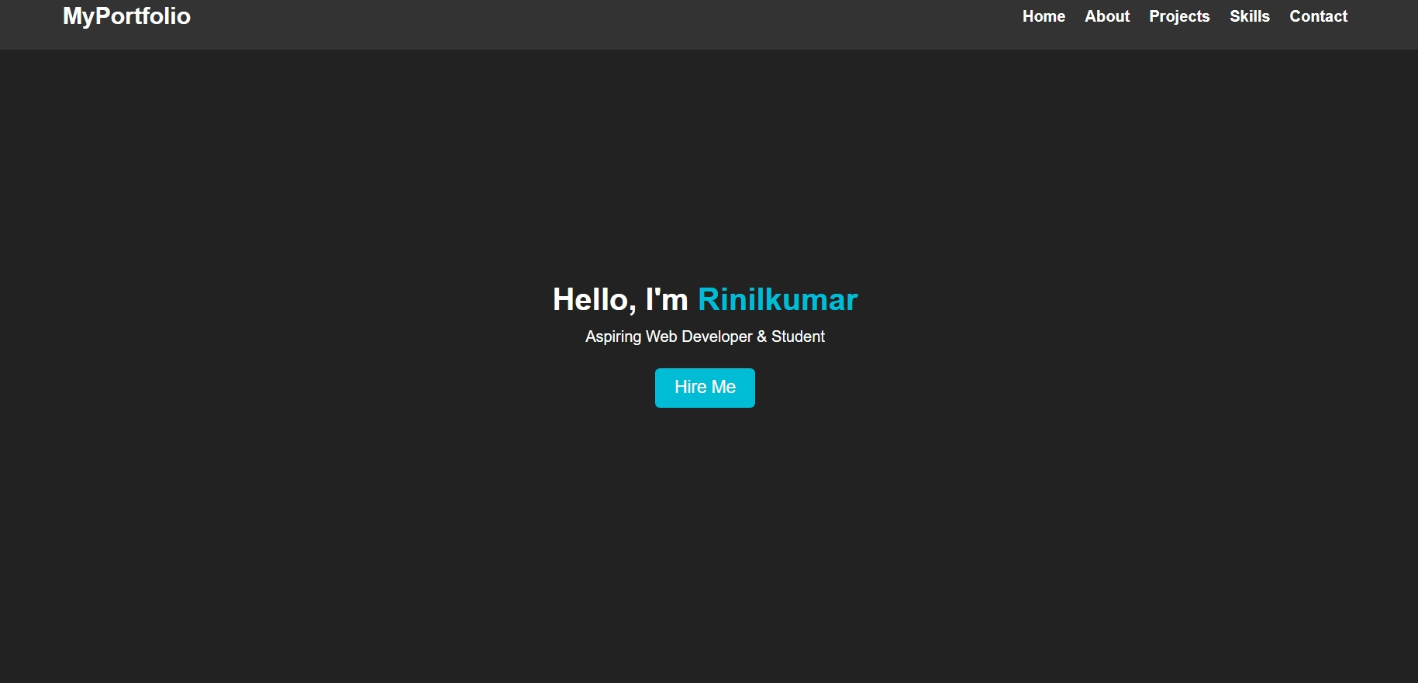

RESULTS AND SCREENSHOTS
3/21/2024 Annual Review
10

Slide 11
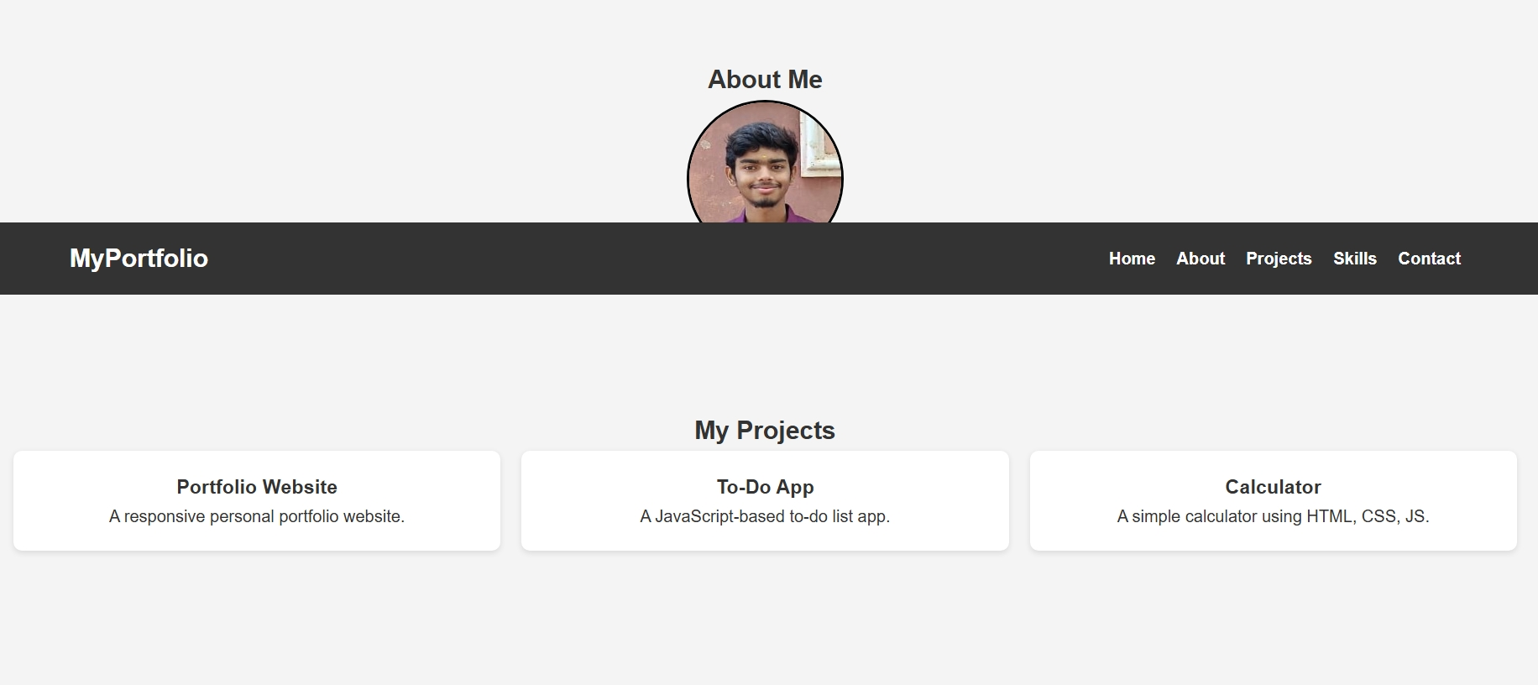

Slide 12
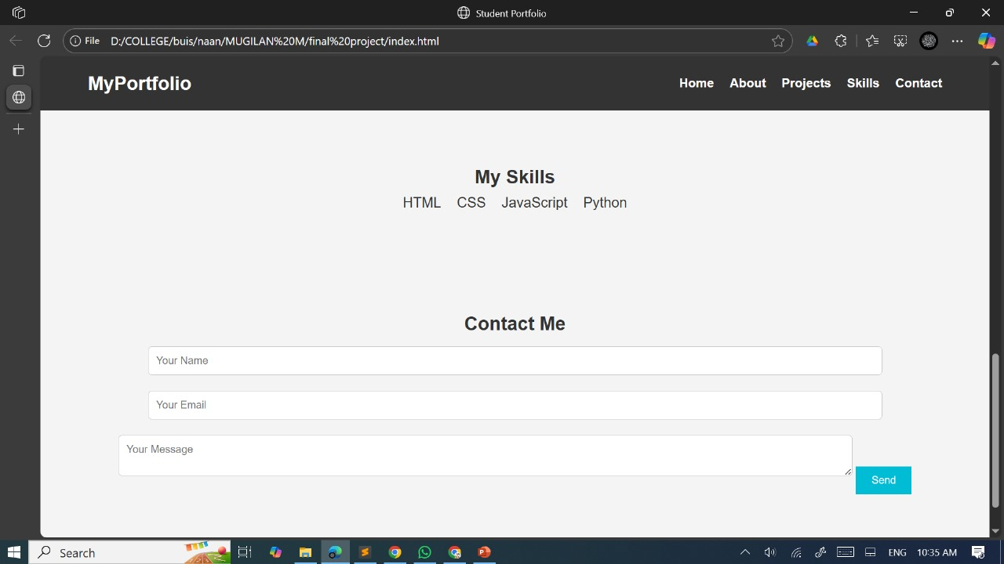

Slide 13
CONCLUSION
The portfolio successfully demonstrates HTML, CSS, and JavaScript integration for building a personal website.
Strengths:
Clean layout and simple navigation Easy integration with Form spree for email functionality.
Suitable for students to showcase work.
13

